Slide 1
Low Power System Design (PVL 207)

Slide 3
Multi-level Voltage Scaling
Multi-level Voltage Scaling (MVS): This is an extension of SVS where two or few fixed voltage domains are used in different parts of a circuit.
Basic Concept: High Vdd gates have less delay, but higher dynamic and static power and low Vdd gates have larger delay but lesser power dissipation.
Voltage islands can be generated at different levels of granularity, such as macro level and standard cell level.
Total power dissipation can be reduced without degrading the overall circuit performance

Slide 4
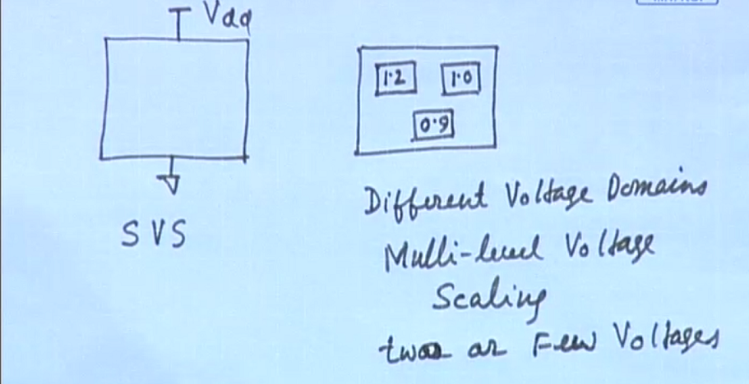

Slide 5
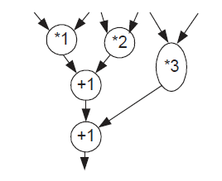
Multiple Vdd Circuits
Macro based voltage island methodology targets toward an entire macro or functional block to be assigned at different voltages at the time of high level synthesis. Starting with an intermediate representation known as directed acyclic graph (DAG), high level synthesis involves two basic steps; scheduling and allocation.
The stack of the off critical path can be utilized for allocation of macro modules of low Vdd to off-critical path operations
Macro based voltage island approach to achieve low power

Slide 6
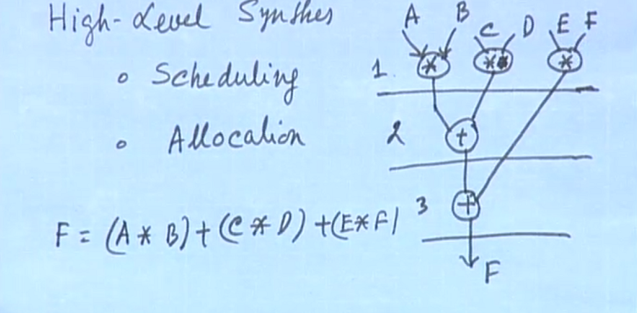

Slide 7
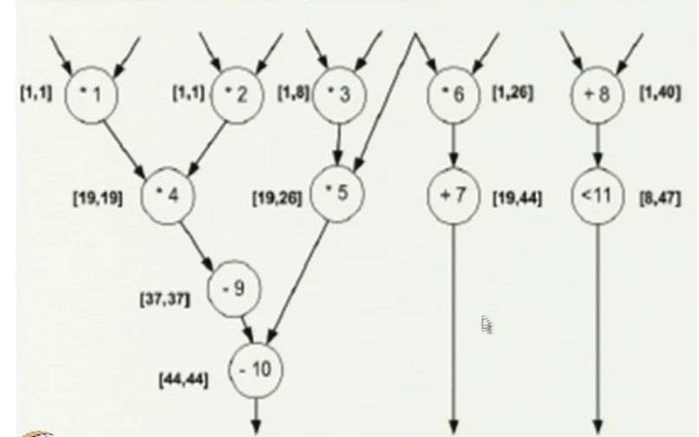
Initial DFG for differential Equation

Slide 8
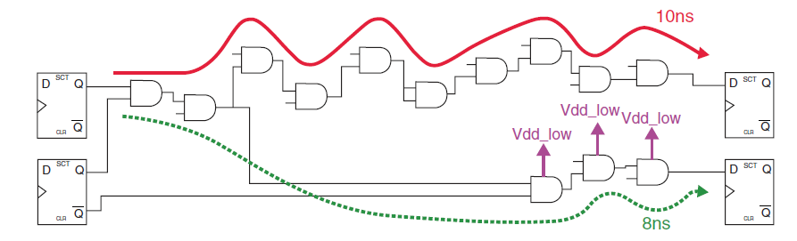
Multiple Vdd Circuits
In the standard-cell level, gates on the critical path and non critical paths are clustered in to two groups
Gates on the critical path are selected from the higher supply voltage (VddH) standard cell library, whereas gates on the non - critical path are selected from the lower supply voltage (VddL) standard cell library
Assignment of multiple supply voltages based on delay on the critical path

Slide 9
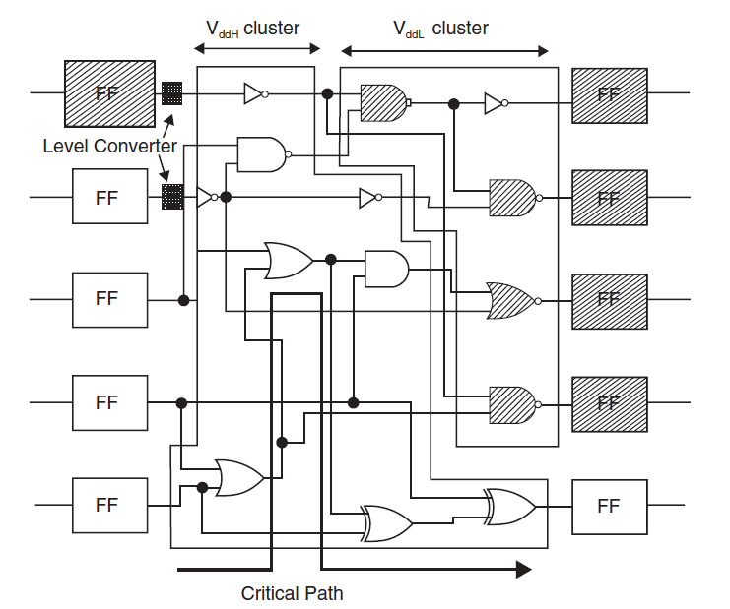
Clustered Voltage Scaling

Slide 10
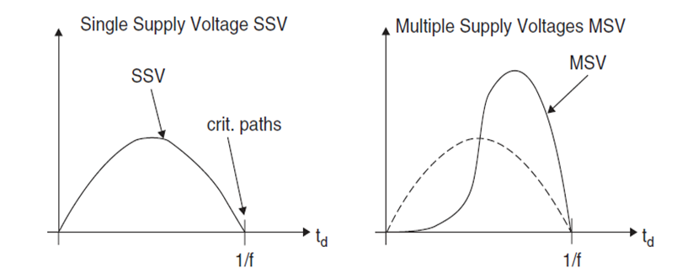
Impact of Clustered Voltage Scaling
Distribution of path delays under single and multiple supply voltages

Slide 11
Issues in multiple Vdd circuits
Voltage Scaling Interfaces
Converter Placement
Floor planning, Routing and Placement
Multiple Supply Voltages
Static Timing Analysis
Power up and Power Down Sequencing
Clock distribution

Slide 12
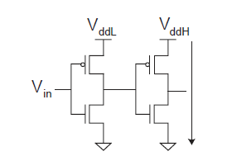
Voltage Scaling Interfaces
When signal go from one voltage domain to another voltage domain, quite often it is necessary to insert level converters or shifters that convert signals of one voltage level to another voltage level.
Consider a signal going from a low Vdd domain to high Vdd domain
A high level output from the low Vdd domain has output VddL , which may turn on both nMOS and pMOS transistors of the high Vdd domain inverter resulting in short circuit between VddH to GND.
A level converter needs to be inserted to avoid this static power consumption.
Signal going for low Vdd to high Vdd domain causing a short circuit current

Slide 13
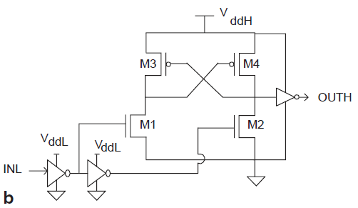
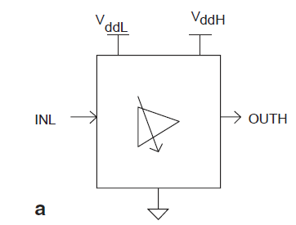
Low to High Voltage level Converters
Driving logic signals from low voltage domain to high voltage domain is critical problem because it has significant degrading effect on the operation of a circuit.
The circuit requires both VddL and VddH supply voltages for its operation. The low to high level converters introduce considerably larger delay compared to the high to low level converters discussed above.
These level converters are to be characterized over an extended voltage range to match different voltage domains of the low and high side of voltage domains for accurate static timing analysis.
a) Logic symbol of high-to-low level converter;
b) High-to-low-voltage level converter realization

Slide 14
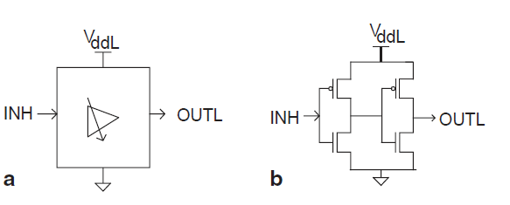
High to Low voltage level Converters
Without a level converter, the voltage swing of the signal reaching the low Vdd domain is 0 to VddH.
This causes higher switching power dissipation and high leakage power dissipation due to GIDL effect.
The rise and fall time may be long leading to increase in short circuit power dissipation.
The high to low level converter is essentially two inverter stages in cascade.
It introduces buffer delay and its impact on the static timing analysis is small.

Slide 15
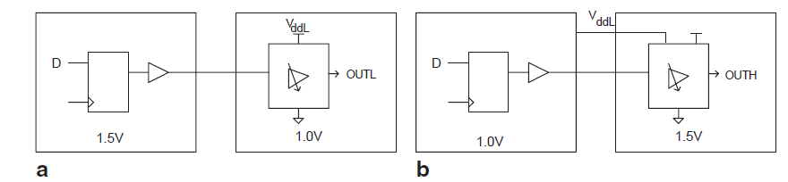
Converter placement
One important design decision in the voltage scaling interfaces is the placement of converters.
As the high-to-low level converters use low Vdd voltage rail, it is appropriate to place them in the receiving or destination domain.
It is also recommended to place the low to high level converters in the receiving domain.
As the low to high level converters require both low and high Vdd supply rails, at least one of the supply rails needs to be routed from one domain to other.
a High-to-low converter placement
b low-to-high converter placement

Slide 16
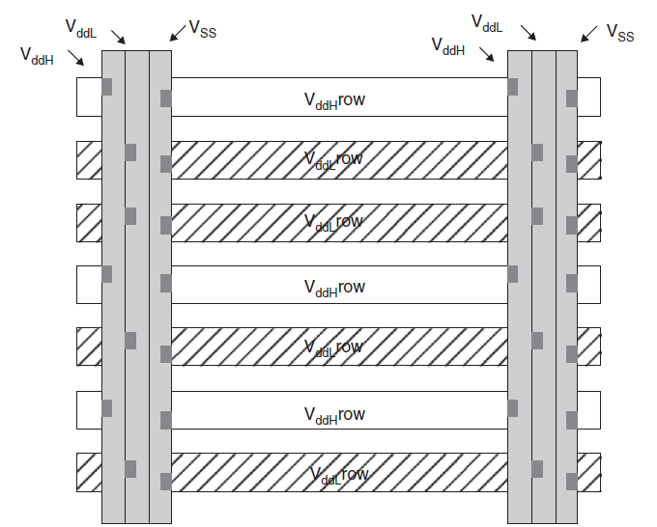
Floor Planning, Routing and Placement
Multiple power domain demands multiple power grid structure and a suitable power distribution among them.
As a consequence, it requires more careful floor planning, placement and routing.
It is necessary to separate low-Vdd and high Vdd cells because they have different n well voltages
Typically a row by row separation is used.
Placement and routing in multiple Vdd design

Slide 17
Multiple Supply Voltages
A number of studies have shown that use of multiple supply voltages results in reduction of dynamic power from less than 10% to about 50%, with an average of about 40%.
It is possible to use more than two say three or four, supply voltages. However, the benefit of using multiple Vdd saturates quickly.
Extending the approach to more than two supply voltages yields only a small incremental benefit.
The major gain is obtained by moving from a single Vdd to dual Vdd.
It has been found that in a dual Vdd / single Vth system, the optimal lower Vdd is about 60-70% of the original Vdd.

Slide 18
Multiple Supply Voltages
The optimal supply voltages depend on the Vdd Vth of the MOS transistors
The smallest Vdd = (Vtn + mod (Vtp))
Assume Vdd1 = 1.5 V, Vth = 0.3 V
Dual Vdd:
Vdd2 = Vdd1(0.5+0.5Vth/Vdd1)= 0.90V
Triple Vdd:
Vdd2 = Vdd1 (0.6+ 0.4Vth/Vdd1)=1.02V
Vdd3 = Vdd2 (0.6+ 0.4Vth/Vdd2 ) = 0.69V
Quad Vdd:
Vdd 2 = Vdd1 (0.7+0.3Vth/Vdd1)=1.14V
Vdd3 = Vdd2 (0.7+0.3Vth/Vdd2) = 0.87V
Vdd4= Vdd3 (0.7+ 0.3Vth/Vdd3)=0.66V

Slide 19
Static Timing Analysis
Use of single voltage makes static timing analysis simpler because it can be performed for single performance point based on characterized libraries.
Electronic Design Automation (EDA) tools can optimize the design for worst case process, voltage and temperature (PVT) conditions.
On the other hand, in case of multi - voltage designs, libraries should be characterized for different voltage levels that are used in the design. EDA tools has to optimize individual blocks or subsystems and also multiple voltage domains.

Slide 20
Power Up and Power down Sequencing
One of the important system level issues is the power sequencing.
To avoid power line glitches, it is not advisable to bring up all power supplies simultaneously.
It is essential to plan a power sequence such that different domains can come up in a well defined order to satisfy correct operation.
Particularly, reset can be initiated only after all power domains are completely powered up.
The ramp time are to be carefully controlled to avoid overshoot and undershoot on the supply lines.

Slide 21
Clock Distribution
As clock needs to be distributed across different voltage domains, the clock have to go through level converters.
This requires that the clock synthesis tool must understand the need for level converters and automatically insert them in appropriate places.

Slide 22
Summary
Multi-level voltage Scaling (MVS)
Macro level
Standard cell level
Issues in MVS

Slide 23
References
Ajit Pal, “Low power VLSI Circuits and Systems” Springer, 2015.

